Slide 1
Improvements to CNN for Human vs. Animal Face Classification
Kareem Piper, Sara Parrish, and Hooman Sabarou
Department of Mathematics & Statistics, University of West Florida
IDC6146: Deep Learning
Dr. Shusen Pu
February 28, 2025

Slide 2
Table of Contents
Background and Motivation
Background(Problem Statement and Purpose of the Study)
Motivation
CNN Foundations
Datasets
Methodological Improvements
Modifications and Results
Code Modifications and Challenges
Results and Comparative Analysis
Future Directions

Slide 3
Background and Motivation
Problem Statement
Facial recognition has evolved significantly since the 1960s, when Woodrow Wilson Bledsoe developed a semi-automatic system requiring manual extraction of facial coordinates (Bledsoe, 1966). Modern advancements, powered by deep learning and convolutional neural networks (CNNs), have expanded applications to Automatic Facial Recognition (AFR) for security and Facial Expression Recognition (FER) for medical diagnostics (Hallowell et al., 2023). While human facial recognition is well-researched, animal face recognition remains underexplored, despite its potential in wildlife conservation and pet identification (Birenbaum et al., 2022). Challenges in animal facial classification include variations in fur patterns and structural differences across species.
Purpose of the Study
This study aims to develop a CNN model for binary classification of human and animal faces, focusing on enhancing accuracy through dataset preprocessing, model tuning, and evaluation using precision, recall, and F1-score metrics. The findings will contribute to the broader field of image classification by providing insights into CNN performance in distinguishing between human and animal faces.

Slide 4
Background and Motivation Cont’d.
Importance of Facial Recognition
Image Classification
Facial recognition is crucial in biometric authentication, surveillance, and has been developed to even detect emotions
Animal facial recognition has been developed for wildlife conservation and can be improved for use in security and pet identification
Advancements in Deep Learning
Newer methods have made traditional methods like Eigenfaces and Principal Component Analysis (PCA) obsolete
The development of Convolutional Neural Networks (CNNs) has increased the accuracy and performance of facial recognition

Slide 5
Background and Motivation Cont’d.
Why Human vs. Animal Face Classification?
While facial recognition was developed using human faces, animal face recognition may still be underexplored
Wildlife applications:
AI-driven recognition for tracking species, monitoring health, and reducing poaching
Potential Challenges in Animal Face Recognition:
Cross-species training
Variations in facial structure, fur

Slide 6
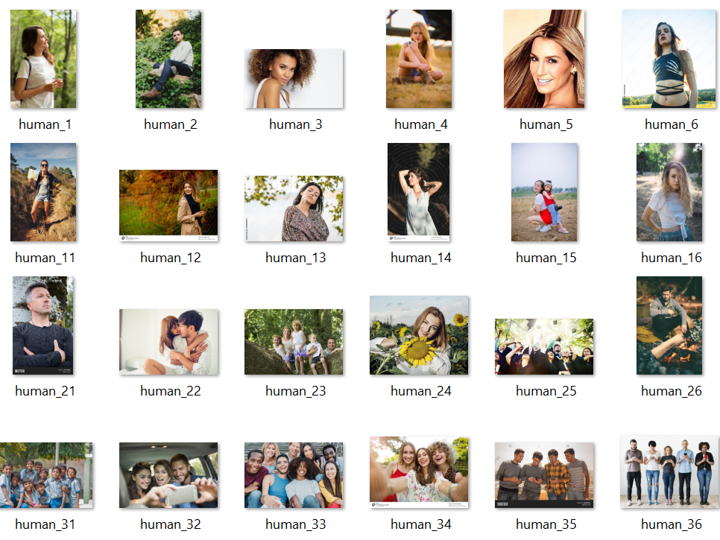
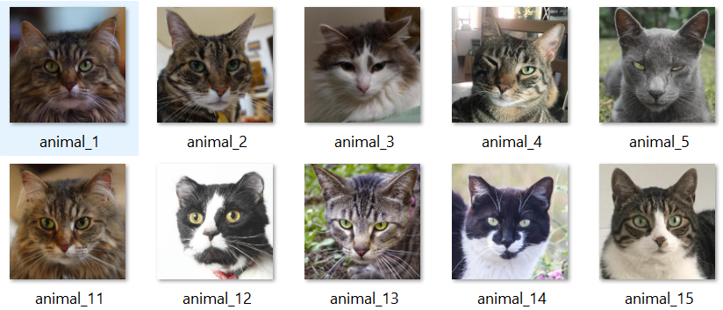
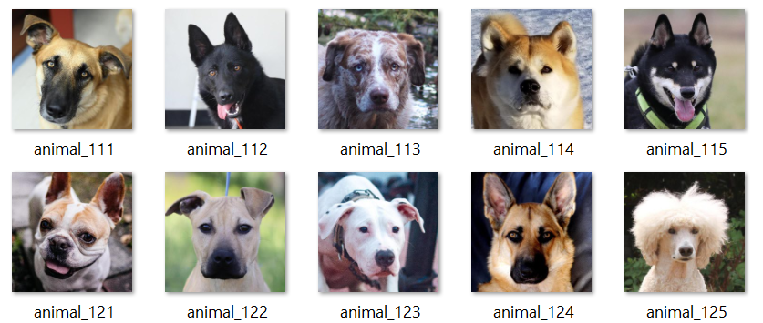
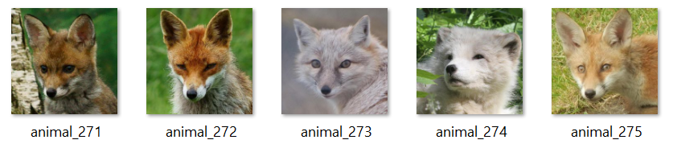
Datasets
Human Faces
Animal Faces

Slide 7
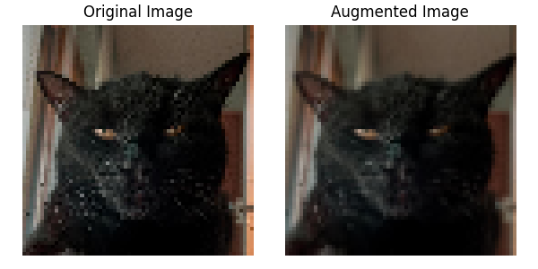
Datasets
Note. Original image after resizing to 64 x 64 pixels (left) and image after random augmentation, shear transform and possibly zoom in (right).

Slide 8
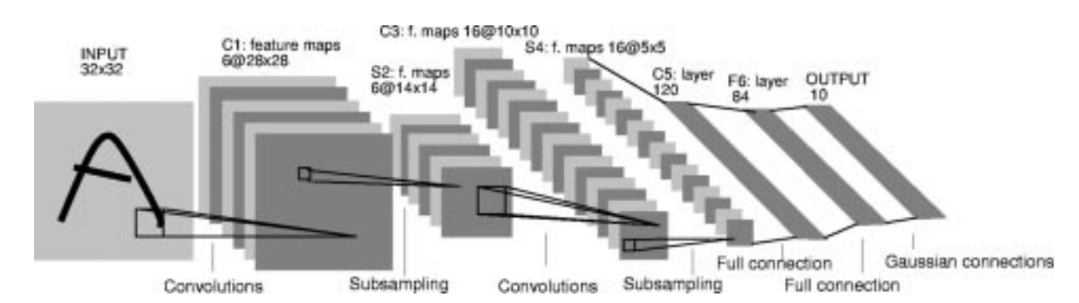
Background and Motivation Cont’d.
LeNet-5 (1998): Developed for the recognition for handwritten digits
AlexNet (2012): Won the ImageNet Large Scale Visual Recognition Challenge (ILSVRC) in 2012 revolutionized the approach to computer vision
LeNet-5 CNN Architecture ( Source: LeCun et al., 1998).
VGGNet, GoogleNet, ResNet (2014, 2015): Further improved image recognition performance with changes to the CNN architecture
More Recent Development in Computer Vision: Vision Transformers (ViTs)
Conventional ViTs are based on two ideas:
self attention
pre-training

Slide 9
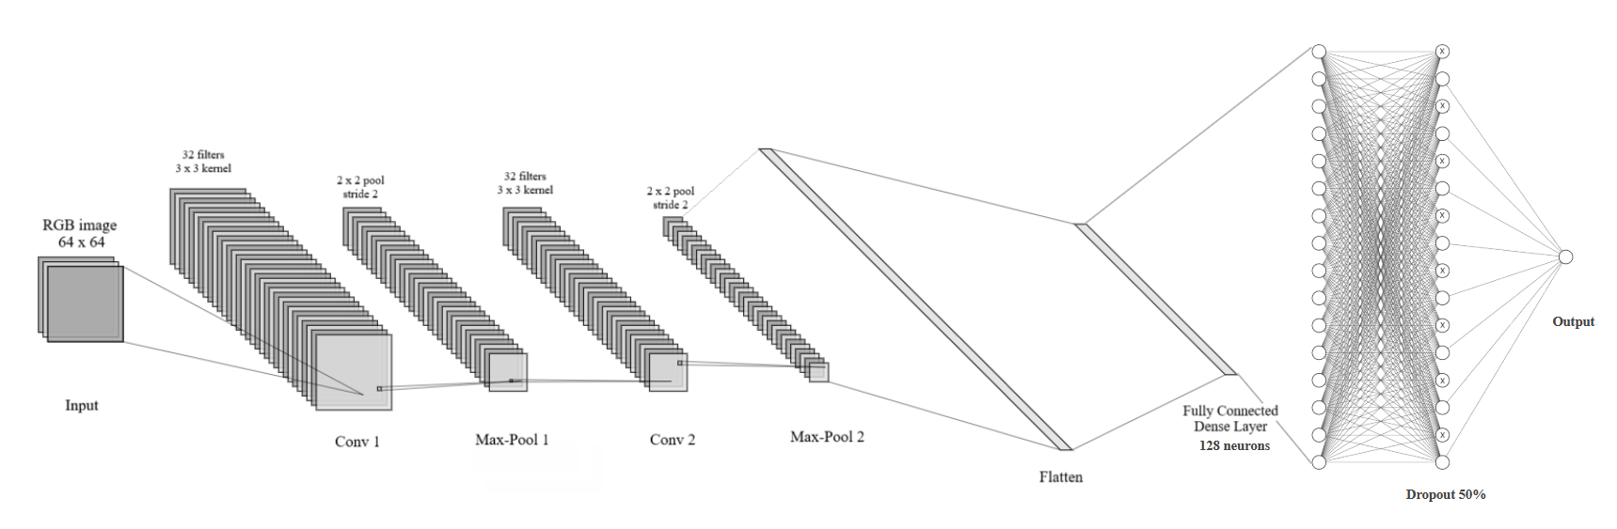
Methodological Improvements Cont’d.
Note. This diagram illustrates the structure of the CNN architecture. Diagram generated using NN-SVG (Lenail, n.d.) and modified to include additional neural network layers.

Slide 10
Methodological Improvements
Model Architecture Enhancements
We implemented a sequential CNN architecture with:
Two Conv2D layers (32 filters, 3x3 kernel, ReLU activation) for feature extraction.
MaxPooling layers instead of AveragePooling to enhance feature retention.
A Flatten layer followed by a fully connected Dense layer (128 units, ReLU activation).
Dropout layer (50%) to mitigate overfitting.
Sigmoid activation in the output layer for binary classification.
Compared to LeNet-5, key differences include:
Different filter sizes and pooling strategy.
ReLU activation in Dense layers instead of Tanh for computational efficiency.
One fully connected layer instead of multiple, reducing model complexity.

Slide 11
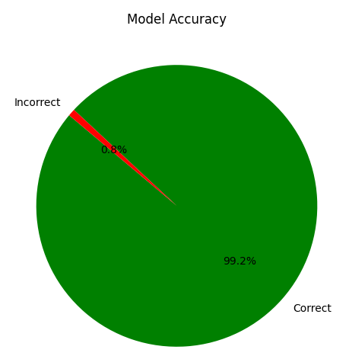
Methodological Improvements Cont’d.
Training Configuration Optimization
We used the Adam optimizer for adaptive learning rate adjustments.
Batch size set to 32 to balance computational efficiency and training speed.
Trained for 50 epochs with EarlyStopping (patience = 5) to prevent overfitting.
We fine-tuned hyperparameters manually across iterations for better performance
Performance Metrics & Observations
We achieved 99.2% accuracy on both validation and test sets.
Precision, recall, and F1-score showed balanced performance.
Confusion matrix analysis revealed 35 misclassifications (20 animals, 15 humans).
ROC curve and scatter plot indicated overconfidence in predictions, with extreme probabilities close to 0 or 1.
Note. The model achieved over 4000 correct predictions with an accuracy of 99.2%.

Slide 12
Methodological Improvements Cont’d.
Error Analysis & Future Improvements
Common misclassification factors included:
Low contrast and poor lighting conditions.
Extreme face angles (>45° from center).
Background complexity and occlusions.
Image resolution degradation affecting feature clarity.
Overconfidence in human classifications led to higher false positives.
Proposed improvements:
We plan to incorporate more data augmentation (rotation, brightness adjustments, occlusion simulation).
Increase image resolution for improved feature extraction.
Enhance convolutional layers and pooling strategies to refine decision boundaries.

Slide 13
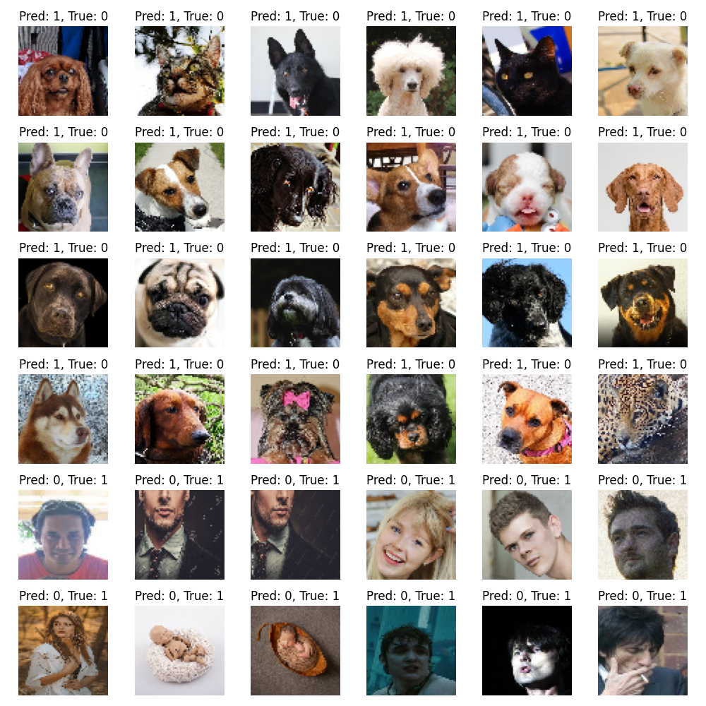
Methodological Improvements Cont’d.
Note. Misclassified images on the test set. There are 24 animals (21 dogs, 2 cats, 1 large cat) and 12 humans (10 adults, 2 newborns).

Slide 14
Code Modifications and Challenges
Challenges Faced:
Metrics Implementation:
Added Precision(), Recall(), and custom F1-score (f1_m) to track performance but struggled with improving F1-score.
Training Duration:
Increased epochs from 25 to 50, but still faced challenges in optimizing F1-score.
Early Stopping:
Implemented early stopping with a patience of 5 epochs, but training continued without improvement beyond Epoch 8, which caused delays.
Best performance was at Epoch 8, but the model reverted to earlier weights during early stopping, preventing further improvement.
Confusion Matrix Issues:
High number of False Positives (FP = 1118) and False Negatives (FN = 1096) indicating difficulty in classifying classes correctly.
Suggested potential thresholding issues affecting model performance.
Experimentation and Hyperparameter Tuning:
Tried increasing batch size, adjusting the learning rate, and applying data augmentation, but F1-score remained below 0.50.
Despite manual coding efforts for F1-score and other optimizations, the model struggled to improve beyond 0.50.

Slide 15
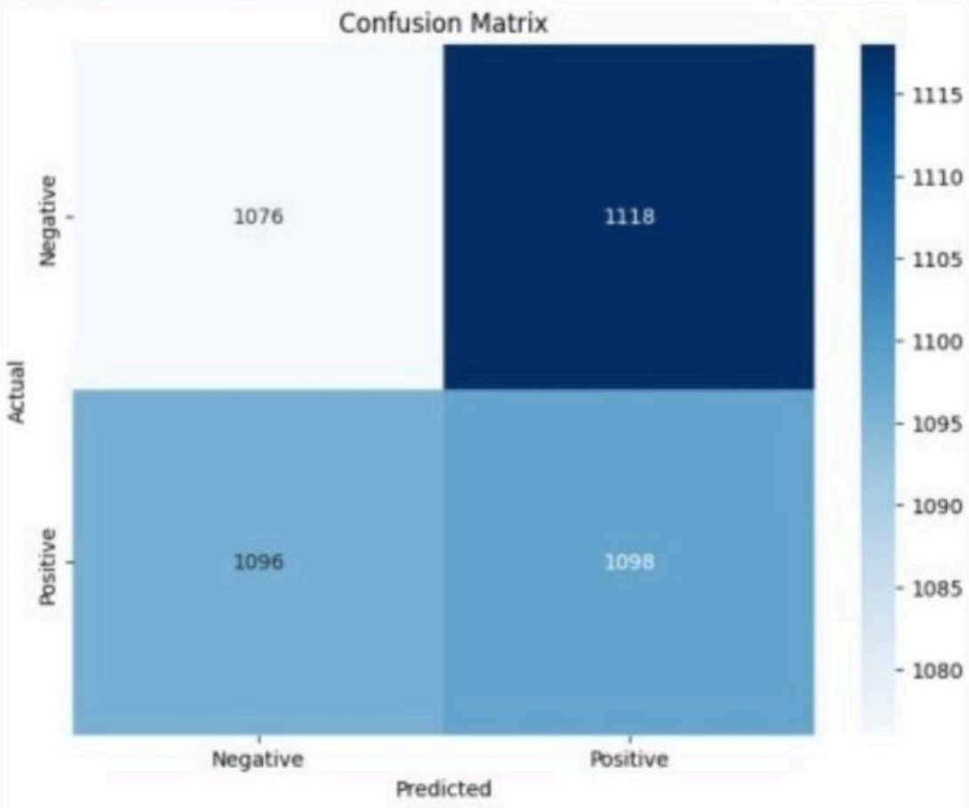
Results and Comparative Analysis:
Epochs
Added precision, recall, and F1-score metrics to monitor performance metrics more comprehensively
Increased from 25 to 50 epochs with early stopping set at 5 for no improvement in the validation F1 score
Epoch 12 (val_f1_m = 15.9589) → This was the highest validation F1-score.
Epoch 13 (val_f1_m = 15.7103) → The validation F1-score dropped.
Best epoch was epoch 8, so early stopping restored the weights from epoch 8.
Note. Confusion Matrix with increased epochs and early stopping for validation F1 score.
Notes:
High False Positives & False Negatives:
There are a significant number of misclassifications in both categories.
FP (1118) means that many actual negative samples are being misclassified as
positive.
FN (1096) indicates that many actual positive samples are being misclassified as
negative.
This suggests that the model might have trouble distinguishing between classes,
possibly due to thresholding issues.

Slide 16
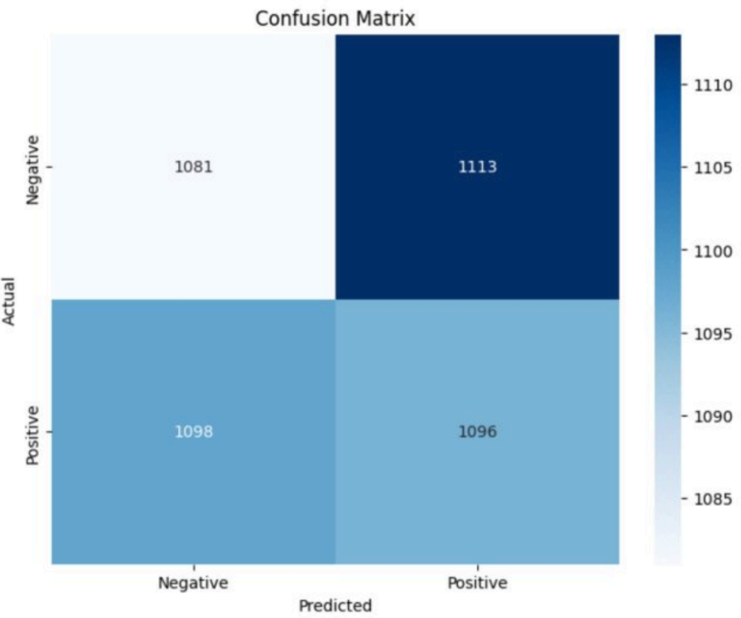
Results and Comparative Analysis: Preprocessing and Training Updates
Updated target size: 64x64 to 128x128
Increased batch size: 32 to 64
Increased data augmentation: Rotation, width and height shift, brightness, fill mode
Added dynamic thresholding which was previously fixed at 0.5
Implemented learning rate scheduling for better optimizer convergence
Added L2 regularization (weight_decay=1e-5) to reduce overfitting
Note. Confusion matrix with updated target size, batch size, and other changes.
Notes:
Updated target size:
Changed the input image size from 64x64 to 128x128 in the ImageDataGenerator
for training data (target_size=(128, 128)), providing higher resolution images for
better feature extraction.
Increased batch size:
Increased the batch size from a smaller value to 64 (batch_size=64) for better
stability and efficiency during training.
Data Augmentation for Training Set:
Added a variety of augmentations to increase the diversity of the training data:
rotation_range=20: Images can be rotated up to 20 degrees.
width_shift_range=0.2: Random horizontal shifts by 20% of the image
width.
height_shift_range=0.2: Random vertical shifts by 20% of the image
height.
shear_range=0.2: Shearing transformations applied to the image.
zoom_range=0.3: Random zoom with a range of up to 30%.
brightness_range=[0.8, 1.2]: Randomly adjust brightness within the given
range.
horizontal_flip=True: Random horizontal flipping of images.
fill_mode='nearest': Fill gaps after transformation using the nearest pixel.
More Training:
Used TensorFlow's built-in Precision() and Recall() for stability: Incorporated Keras'
built-in Precision and Recall metrics to ensure consistent and reliable performance
monitoring.
Added Dynamic Thresholding (adjusted_threshold()) instead of fixed 0.5:
Implemented a custom thresholding mechanism to adjust the decision threshold
dynamically, providing more flexibility and better classification performance.
Implemented Learning Rate Scheduling → Better optimizer convergence: The
optimizer now uses a learning rate of 0.001 with L2 regularization (weight_decay=1e-5),
which helps avoid overfitting and improves convergence.
Added L2 Regularization (weight_decay=1e-5) to reduce overfitting: L2 regularization
was added to penalize large weights, which helps the model generalize better to unseen
data.
Observations:
1. High False Positives (FP = 1113)
A large number of actual negatives are being misclassified as positive.
This could indicate a bias towards predicting the positive class too frequently.
2. High False Negatives (FN = 1098)
Many actual positives are misclassified as negative.
The model struggles to distinguish between classes, affecting recall.
3. Balanced TP and TN Counts
The model correctly identifies both positive and negative classes to a similar extent.
However, the misclassification rates are nearly equal, reducing overall model
effectiveness.

Slide 17
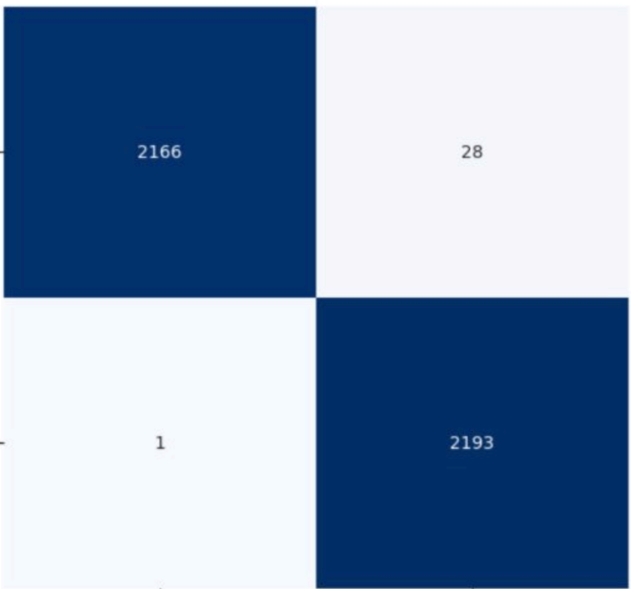
Results and Comparative Analysis:
Other Attempts
Increased batch size
Manually tuned learning rate
Manually coded F1 function to ensure compatibility
In subsequent trainings, the model would not exceed an F1 of 0.5 indication random classification
Note. Confusion matrix after a variety of adjustments, though this iteration of the model was not used due to a poor performance metrics.
Notes:
Tried a bunch of experimentation with tuning even increased batch sizes, did some
coding to try and figure out the most ideal learning rate to improve F1.I even manual
coded F1 function, nothing worked. So, I went back to initial model and just added the
other metrics Ecil wanted basically started over after training all night. The F1 has been
very problematic. Below is the best confusion matrix I got from my experiments, but then
I nuked everything. I can’t get F1 over .50. This typically arises if the data sets are
imbalanced but our data set is 100% balanced.

Slide 18
Code Modifications and Challenges Cont’d.
Balanced Dataset but Poor Performance:
Despite a balanced dataset, the model's performance remained suboptimal due to challenges in distinguishing between classes, especially with F1-score.
Extremely Long Tuning Time:
Hyperparameter tuning took an extended period, with some trials (e.g., Trial 60) taking over 4 hours (4h 14m 18s) to complete, making the process time-consuming.
Despite the lengthy duration, the tuning did not significantly improve the base model's performance.
Limited Improvement from Hyperparameter Tuning:
Although the tuning attempted to optimize various hyperparameters, such as filter sizes, dropout rates, learning rates, and dense units, the best validation accuracy achieved was around 99.17% (from Trial 60), which did not lead to substantial improvements over the baseline model.
The model’s accuracy and performance did not significantly improve beyond initial configurations, indicating the tuning process was inefficient in this case.

Slide 19
Code Modifications and Challenges Cont’d.
Resource Constraints and High GPU Memory Usage:
GPU Memory Usage was close to full capacity (14,412 MiB out of 16,376 MiB), which could have caused resource constraints, especially with the large batch sizes and extended training times.
This high GPU usage and limited memory could have impacted the system’s efficiency, possibly leading to slower training times.
Potential Overfitting Despite Early Stopping:
The tuning process still exhibited overfitting issues despite the implementation of early stopping with patience set to 3 epochs, as evidenced by the drop in accuracy in later epochs (e.g., Trial #61 showing 87.81% accuracy in Epoch 1).
Early stopping tried to mitigate overfitting, but it didn't prevent the model from showing signs of instability during the hyperparameter search.

Slide 20
Code Modifications and Challenges Cont’d.
Inconsistent Results Across Trials:
Variability in trial results (e.g., Trial #61 showing high dropout values and learning rates) suggests inconsistent hyperparameter effects, making it difficult to find an optimal configuration.
The model's behavior varied significantly across different trials despite using the same dataset, which made finding the ideal configuration even more challenging.
GPU Utilization Conflict with Other Processes:
The nvidia-smi output indicated that other processes, like gnome-shell and firefox, were utilizing GPU memory alongside the model's training, which could have interfered with the model's training efficiency and performance.
Ideally, dedicating GPU resources to training without interference from other processes could improve performance and reduce training times.

Slide 21
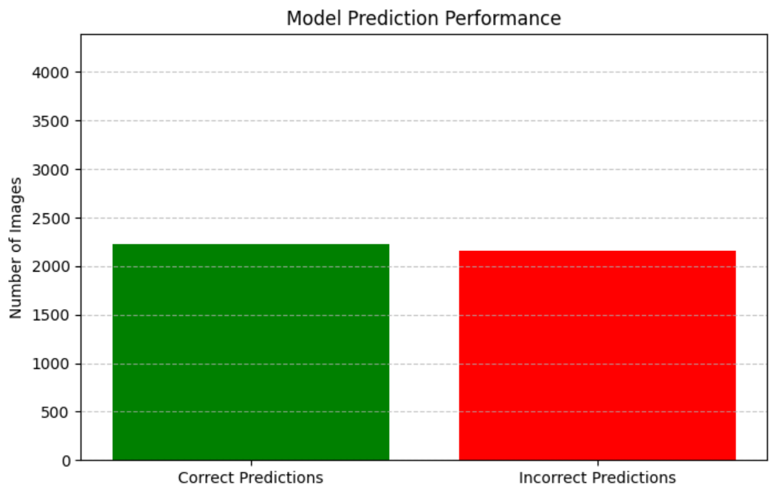
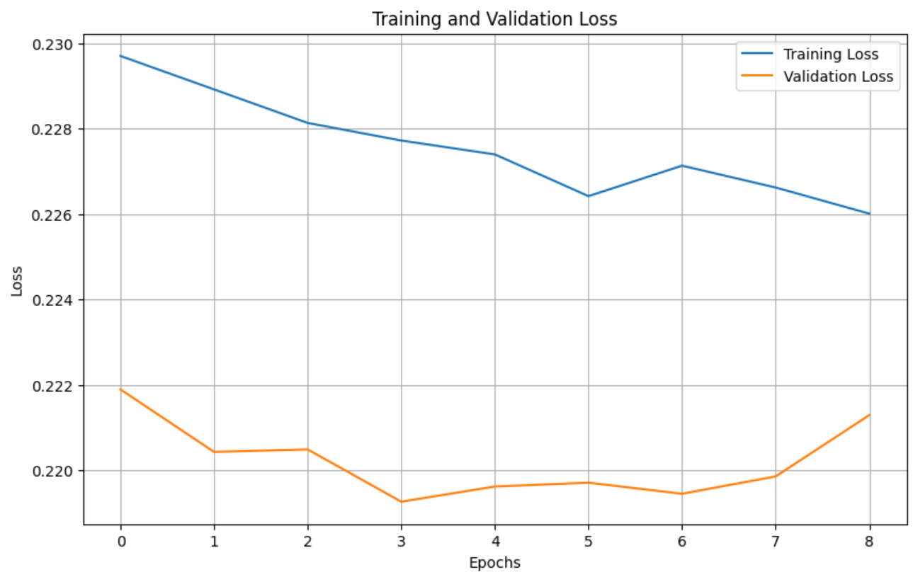
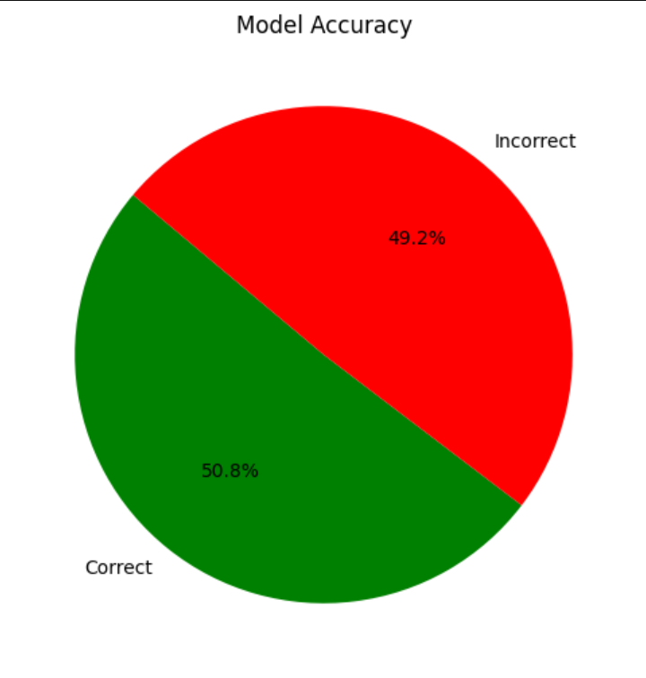
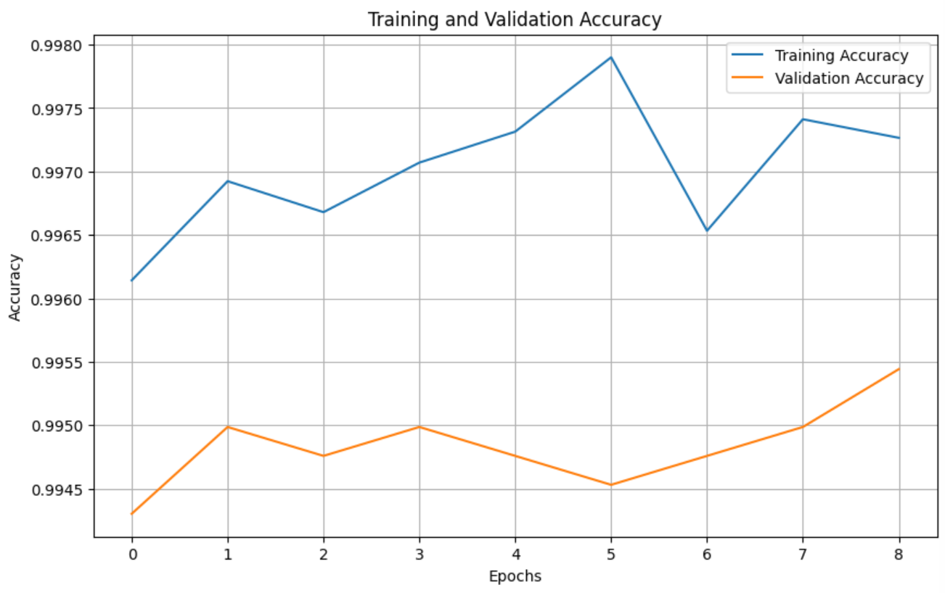
Results and Comparative Analysis:
Other Attempts
Attempt to Lessen Overconfidence
Increased label smoothing
0.05 → 0.1
Decreased learning rate
0.0005 → 0.0002

Slide 22
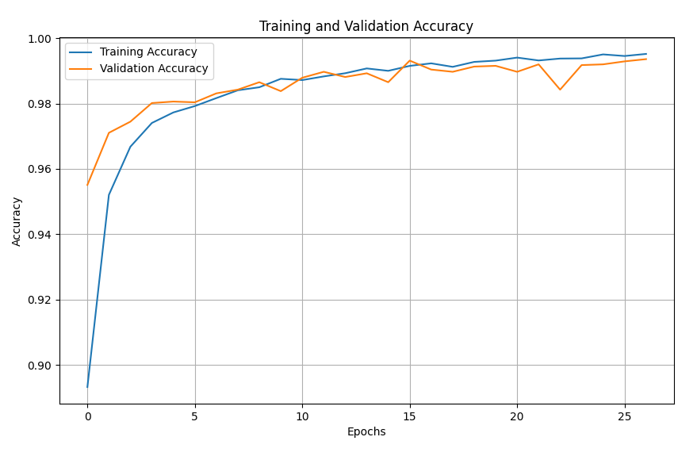
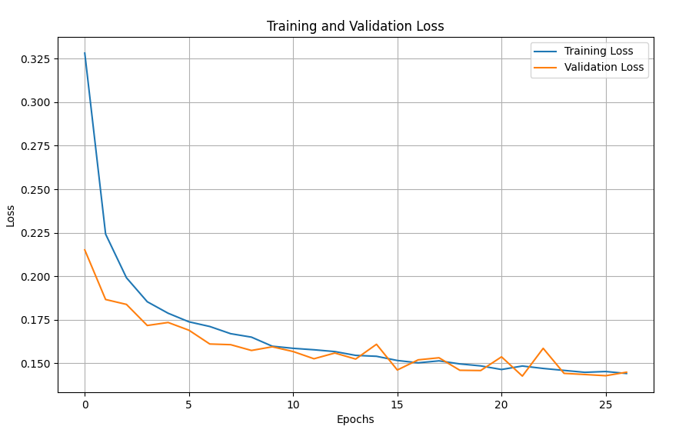
Results and Comparative Analysis Cont’d.
Note. Curves for model training and validation accuracy (left) and training and validation loss (right) over 27 epochs.

Slide 23
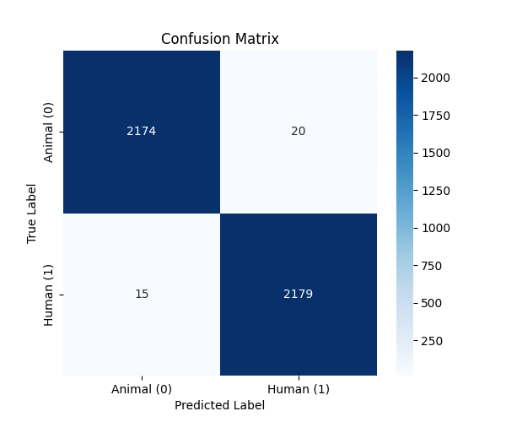
Results and Comparative Analysis Cont’d.
F1 Score calculation was reassessed
A score of 0.99 was achieved
Note. Confusion matrix for validation set, initial model.

Slide 24
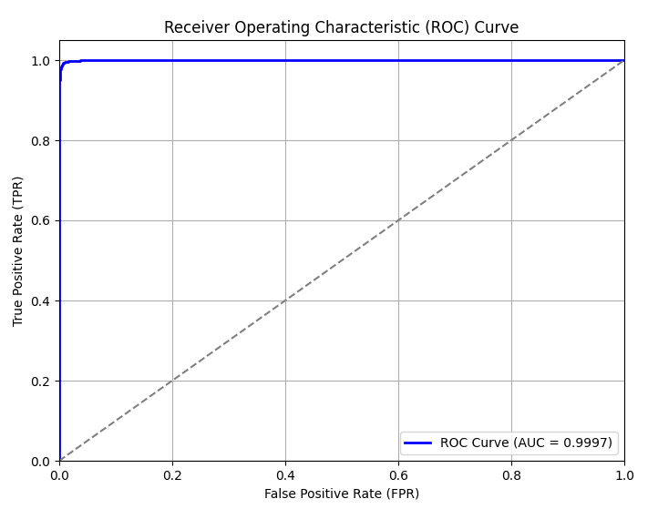
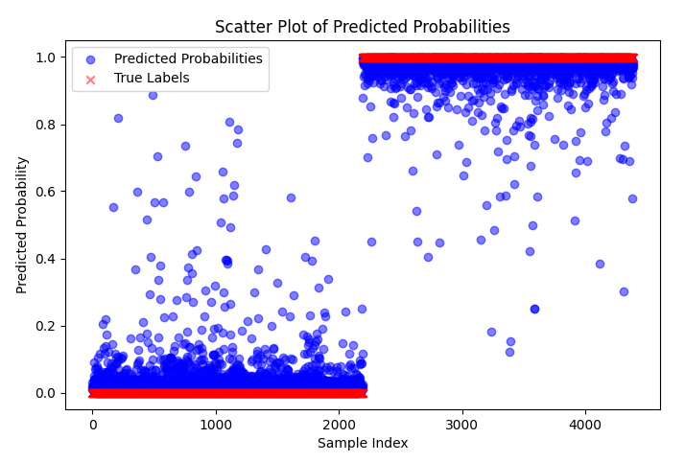
Results and Comparative Analysis Cont’d.
Note. The Receiver Operating Characteristic curve (ROC) for the validation set with AUC = 0.9997 (left) and a scatter plot of predicted probabilities (right) indicating overconfidence in the model.

Slide 25
Results and Comparative Analysis
Limitations and Remaining Issues
Dataset Limitations and Generalization Challenges
Limited Species Representation
Potential Bias in the Human Dataset
Overconfidence in Classification and Misclassification Issues
High Confidence in Incorrect Predictions
Error Analysis Reveals Common Failure Cases
Model Complexity and Computational Costs
Training Time and Resource Constraints
Limited Feasibility for Real-Time Deployment

Slide 26
Future Directions
Broader Implications
Improving AI-Assisted Facial Recognition in Challenging Environment
Adopting the model for low-light, occluded, or distorted images → better performance in real-world security and wildlife monitoring.
Benchmarking Deep Learning Approaches for Non-Human Face Recognition
This study contributes to establishing a benchmark for animal face classification (most recognition benchmarks focus on human datasets)
Bridging the GAP Between AI Ethics and Model Bias
The dataset composition impacts classification accuracy. This research can inform best practice for dataset curation to prevent species or demographic bias in AI models.
The model’s overconfidence in human classifications suggests that bias in training data can skew probability distributions, reinforcing the importance of fail AI practices.

Slide 27
Future Directions
Expanding Beyond Binary Classification
Extend the model to multi-class classification, allowing it to differentiate between different animal species or specific categories of human faces.
Improve generalization by incorporating a more diverse dataset beyond just dogs, cats, and large mammals.
Enhancing Model Performance
Use transfer learning by fine-tuning pre-trained CNN models to improve feature extraction.
Explore Vision Transformers (ViTs) as an alternative to CNNs to see if they improve accuracy in distinguishing human and animal faces.
Potential Applications
Wildlife Conservation: AI-based animal identification can be used for population monitoring and poaching prevention.
Pet Identification & Security: Facial recognition for pets can be applied in smart pet doors and home security.
Biometric Security: Improved human facial recognition could enhance authentication in security applications.

Slide 28
Future Directions
Potential Next Steps
Improving Model Interpretability and Confidence Calibration
Addressing overconfidence in CNN predictions by incorporating Bayesian deep learning to estimate uncertainty in classifications
Investigating alternative activation functions beyond ReLU to mitigate misclassification of low-contrast or ambiguous images.
Optimizing Model Efficiency for Real-Time Applications
Implementing neural architecture search (NAS) to automate model tuning and improve performance without excessive manual hyperparameter tuning.
Reducing computational cost using quantization-aware training for deployment on mobile and embedded systems AI systems.
Exploring Few-Shot and Self-Supervised Learning for Law-Data Scenarios
Instead of relying on large manually labeled datasets, future work could investigate self-supervised learning (SSL) methods.
Few-shot learning approaches could allow the model to generalize across species with limited samples, making it more adaptable to real -world conditions.

Slide 29
Thank You!
Summary of Key Takeaways
What worked well and what didn’t
Major improvements and their impact
Key learning experiences

Slide 30
References
Abadi, M., Agarwal, A., Barham, P., Brevdo, E., Chen, Z., Citro, C., Corrado, G. S., Davis, A., Dean, J., Devin, M., Ghemawat, S., Goodfellow, I., Harp, A., Irving, G., Isard, M., Jia, Y., Jozefowicz, R., Kaiser, L., Kudlur, M., ... Zheng, X. (2015). TensorFlow: Large-scale machine learning on heterogeneous systems. https://www.tensorflow.org/
Adjabi, I., Ouahabi, A., Benzaoui, A., & Taleb-Ahmed, A. (2020). Past, present, and future of face recognition: A review. Electronics, 9(8), 1188. https://doi.org/10.3390/electronics9081188
Andrewmvd. (2020). Animal faces [Data set]. Kaggle. https://www.kaggle.com/datasets/andrewmvd/animal-faces
Bledsoe, W. W. (1963, January). A facial recognition project report. Panoramic Research, Inc. https://archive.org/details/firstfacialrecognitionresearch
Bergstra, J., & Bengio, Y. (2012). Random search for hyper-parameter optimization. Journal of Machine Learning Research, 13(1), 281–305. https://jmlr.csail.mit.edu/papers/volume13/bergstra12a/bergstra12a.pdf
Birenbaum, Z., Do, H., Horstmyer, L., Orff, H., Ingram, K., & Ay, A. (2022). SEALNET: Facial recognition software for ecological studies of harbor seals. Ecology and Evolution, 12(5), e8851-n/a. https://doi.org/10.1002/ece3.8851
Chen, J., & Ran, X. (2019). Deep learning with edge computing: A review. Proceedings of the IEEE, 107(8), 1655–1674. https://doi.org/10.1109/JPROC.2019.2921977
Chen, T., Kornblith, S., Norouzi, M., & Hinton, G. (2021). A simple framework for contrastive learning of visual representations. In International Conference on Machine Learning, 1597–1607. arXiv preprint, arXiv: 2002.05709. https://doi.org/10.48550/arXiv.2002.05709

Slide 31
References
Chicco, D., & Jurman, G. (2020). The advantages of the Matthews correlation coefficient (MCC) over F1 score and accuracy in binary classification evaluation. BMC Genomics, 21, 6. https://doi.org/10.1186/s12864-019-6413-7
Choi, Y., Uh, Y., Yoo, J., & Ha, J.-W. (2020). StarGAN v2: Diverse image synthesis for multiple domains. In Proceedings of the IEEE Conference on Computer Vision and Pattern Recognition. https://www.kaggle.com/datasets/andrewmvd/animal-faces
Chollet, F., & others. (2015). Keras. GitHub. Retrieved from https://github.com/fchollet/keras
Clapham, M., Nevin, O. T., Ramsey, A. D., & Rosell, F. (2020). Automated facial recognition for wildlife that lack unique markings: A case study on brown bears. Ecology and Evolution, 10(7), 3504–3515. https://doi.org/10.1002/ece3.6840
Dagher, I., & Barbara, D. (2021). Facial age estimation using pre-trained CNN and transfer learning. Multimedia Tools and Applications, 80(13), 20369-20380. https://doi.org/10.1007/s11042-021-10739-w
Dosovitskiy, A., Beyer, L., Kolesnikov, A., Weissenborn, D., Zhai, X., Unterthiner, T., ... & Houlsby, N. (2021). An image is worth 16×16 words: Transformers for image recognition at scale. International Conference on Learning Representations. arXiv preprint, arXiv: 2010.11929. https://doi.org/10.48550/arXiv.2010.11929
Gupta, A. (n.d.). Human Faces [Data set]. Kaggle. https://www.kaggle.com/datasets/ashwingupta3012/human-faces
Hallowell, N., Badger, S., McKay, F., Kerasidou, A., & Nellåker, C. (2023). Democratising or disrupting diagnosis? Ethical issues raised by the use of AI tools for rare disease diagnosis. SSM. Qualitative Research in Health, 3, 100240–100240. https://doi.org/10.1016/j.ssmqr.2023.100240

Slide 32
References
Jamieson, K., & Talwalkar, A. (2016). Non-stochastic best arm identification and hyperparameter optimization. In Proceedings of the 19th International Conference on Artificial Intelligence and Statistics (AISTATS) (pp. 240–248). PMLR. https://proceedings.mlr.press/v51/jamieson16.html
Khan, S., Naseer, M., Hayat, M., Zamir, S. W., Khan, F. S., & Shah, M. (2022). Transformers in vision: A survey. ACM Computing Surveys, 54(10s), 1-41. https://doi.org/10.1145/3505244
Lecun, Y., Bottou, L., Bengio, Y., & Haffner, P. (1998). Gradient-based learning applied to document recognition: Intelligent signal processing. Proceedings of the IEEE, 86(11), 2278–2324. http://dx.doi.org/10.1109/5.726791
Lenail, A. (n.d.). NN-SVG: Publication-ready neural network architecture schematics [Computer software]. https://alexlenail.me/NN-SVG/LeNet.html
Li, L., Jamieson, K., Rostamizadeh, A., Gonina, E., Ben-Tzur, J., Hardt, M., Recht, B., & Talwalkar, A. (2020). A system for massively parallel hyperparameter tuning. Proceedings of Machine Learning and Systems (Vol. 2, pp. 230–246). https://proceedings.mlsys.org/paper_files/paper/2020/file/a06f20b349c6cf09a6b171c71b88bbfc-Paper.pdf
Parker, C. (2021). Facial recognition to save elephants from poachers. Save The Elephants. https://savetheelephants.org/news/facial-recognition-to-save-elephants-from-poachers/
Powers, D. M. W. (2020). Evaluation: From precision, recall and F-measure to ROC, informedness, markedness & correlation. Journal of Machine Learning Technologies, 2(1), 37–63. arXiv preprint, arXiv: 2010.16061. https://doi.org/10.48550/arXiv.2010.16061
Prechelt, L. (1998). Early stopping—but when? In G. B. Orr & K.-R. Müller (Eds.), Neural networks: Tricks of the trade (pp. 55–69). Springer. https://doi.org/10.1007/3-540-49430-8_3
Raschka, S., Liu, Y., Mirjalili, V., & Dzhulgakov, D. (2022). Machine learning with PyTorch and Scikit-Learn: Develop machine learning and deep learning models with Python. Packt Publishing.

Slide 33
References
Rescigno, M., Spezialetti, M., & Rossi, S. (2020, 12). Personalized models for facial emotion recognition through transfer learning. Multimedia Tools and Applications, 79(47-48), 35811-35828. https://doi.org/10.1007/s11042-020-09405-4
Shahinfar, S., Meek, P., & Falzon, G. (2020). “How many images do I need?” Understanding how sample size per class affects deep learning model performance metrics for balanced designs in autonomous wildlife monitoring. Ecological Informatics, 57, 101088. https://doi.org/10.1016/j.ecoinf.2020.101088
Shukla, A., Cheema, G. S., Anand, S., Qureshi, Q., & Jhala, Y. (2019). Primate face identification in the wild. arXiv preprint, arXiv:1907.02642. https://doi.org/10.48550/arXiv.1907.02642
Sokolova, M., & Lapalme, G. (2009). A systematic analysis of performance measures for classification tasks. Information Processing & Management, 45(4), 427–437. https://doi.org/10.1016/j.ipm.2009.03.002
Ultralytics. (2023). Monitoring animal behavior using Ultralytics YOLOv8. Ultralytics. https://www.ultralytics.com/blog/monitoring-animal-behavior-using-ultralytics-yolov8
Wang, F., Zhang, M., Wang, X., Ma, X., & Liu, J. (2020). Deep learning for edge computing applications: A state-of-the-art survey. IEEE Access, 8, 58322–58336. https://doi.org/10.1109/ACCESS.2020.2982411
Wang, S., Liu, W., Wu, J., Cao, L., Meng, Q., & Kennedy, P. J. (2016). Training deep neural networks on imbalanced data sets. In 2016 International Joint Conference on Neural Networks (IJCNN) (pp. 4368-4374). IEEE. https://doi.org/10.1109/IJCNN.2016.7727770
Wang, X., Khan, A., Wang, J., Gangopadhyay, A., Busart, C. E., & Freeman, J. (2022). An edge-cloud integrated framework for flexible and dynamic stream analytics. arXiv preprint, arXiv:2205.04622. https://arxiv.org/pdf/2205.04622
Zhao, H., Cui, H., & Wang, X. (2023). Exploring self-supervised vision transformers for deepfake detection. arXiv preprint, arXiv:2405.00355. https://arxiv.org/pdf/2405.00355

